Slide 1

Case Study 2
A Look Into Attrition
John Girard

Slide 2

Where are we today?
We will be looking at attrition and income of FritoLay Employees today
We received this data from HR that comes directly from your employees
We made the decision to forgoe some pieces of data we found redundant

Slide 3

The Most Common Reasons for Attrition
Overworked
Seeking a challenge
Development opportunities
Compensation

Slide 4
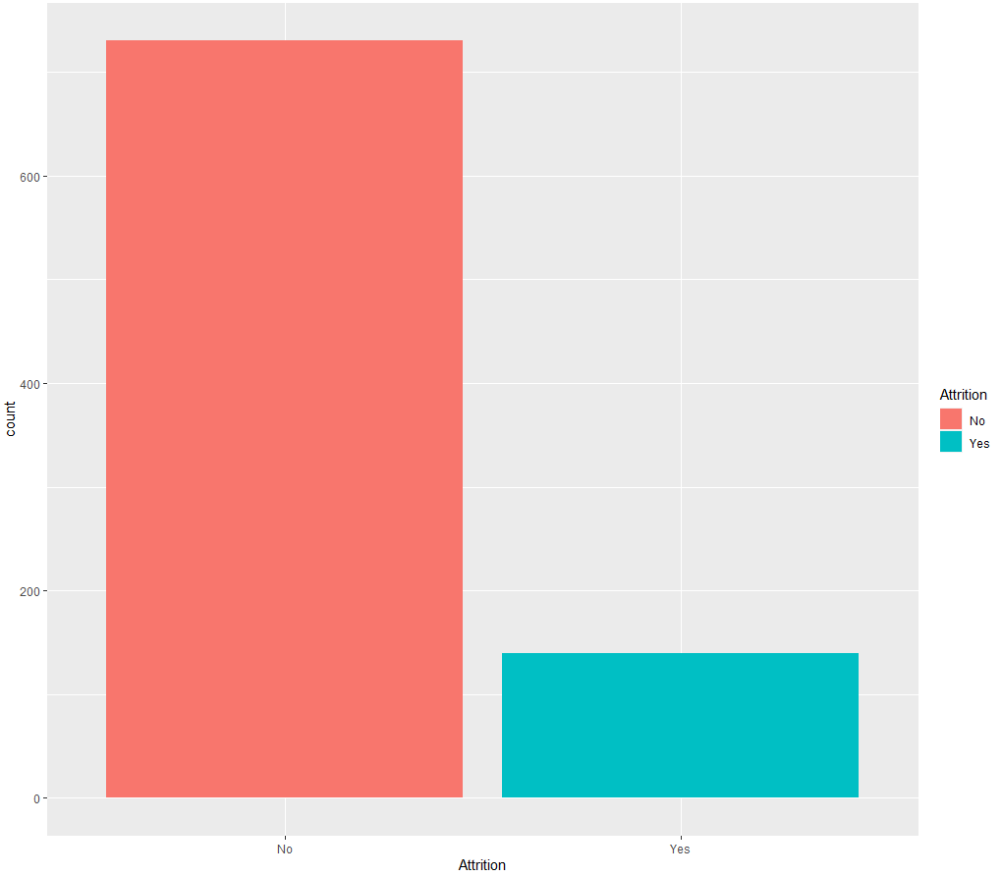
Attrition

Slide 5

How We Broke This Down
We looked at this broad first
Created models to capture information with machine learning

Slide 6
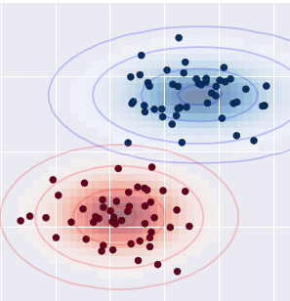
Naive Bayes Model
The Naive Bayer Model I used was 85% accurate, 90% sensitivity, and 59% specific.
Some of the strongest categories I found were :
Overtime
YearsWithCurrManager
JobRole

Slide 7
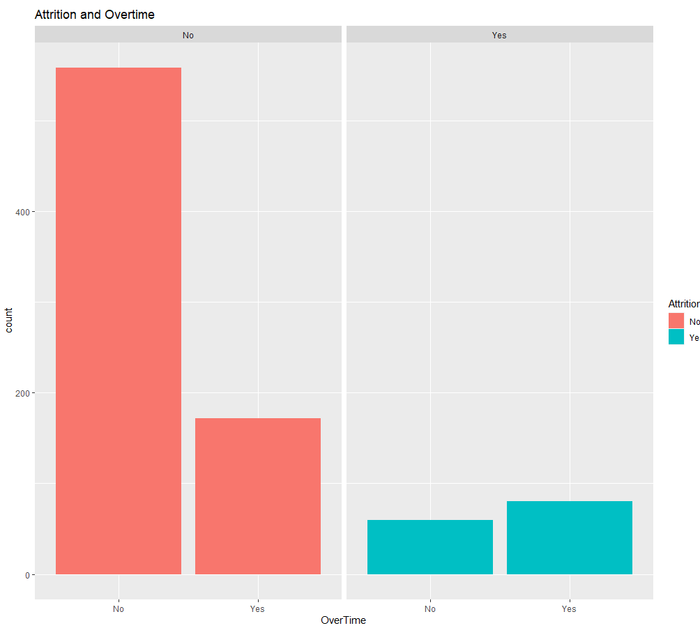
Attrition and Overtime
People with feelings of Attrition cite overtime as an issue. The reverse is true

Slide 8
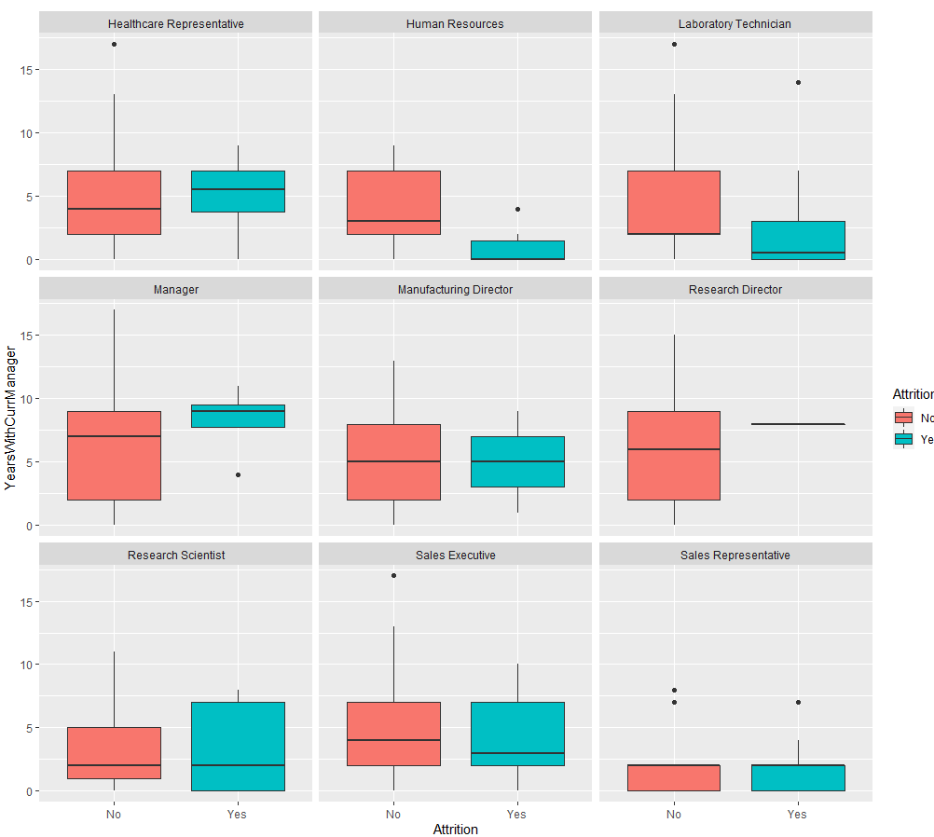
Job Role and Years With a Manager vs Attrition
Sales Rep’s are most likely to leave their Jobs
There is a sweetspot on most Years With Current Managers

Slide 9

Monthly Incomes
For us to predict incomes for employees we again had to reexamine the data broadly

Slide 10
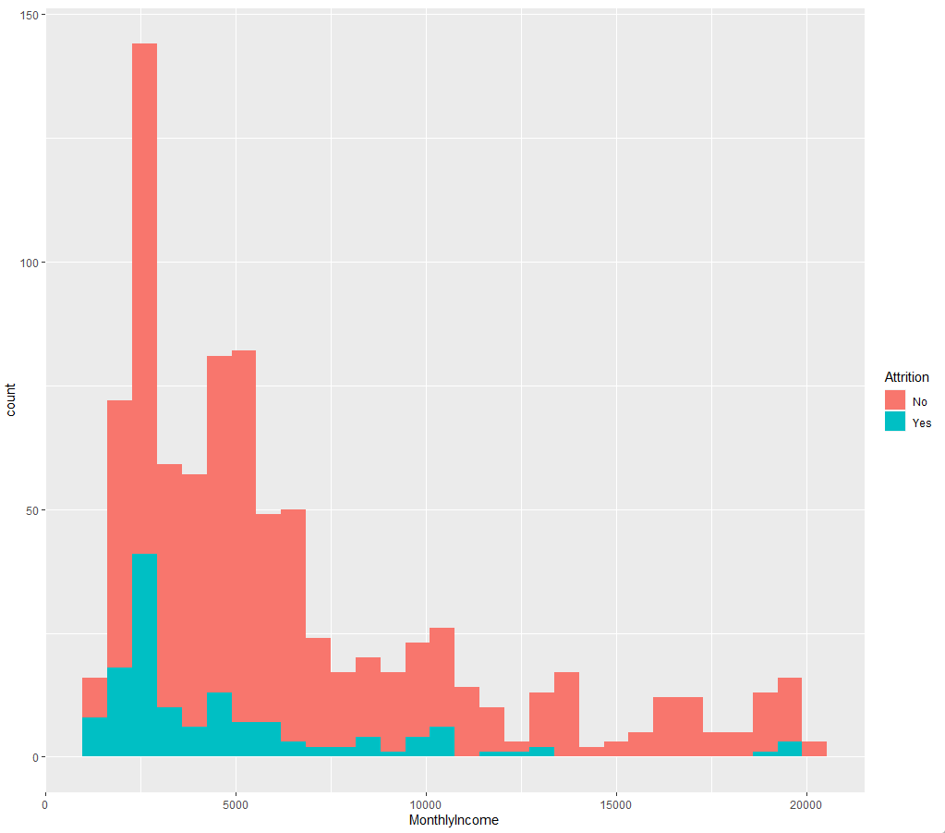
Monthly Incomes
This is what the salary's range from at FritoLay now

Slide 11

Linear Regression and Cross Validation To Predict Income
Our Key predictors were:
Job Level
Years With Current Manager
Years At Company
Total Working Years

Slide 12
Results
I was able to find a RMSE of $1057 after using the cross-validated LM.
The $ being this close to the line of best fit lets our team know we are accurate

Slide 13
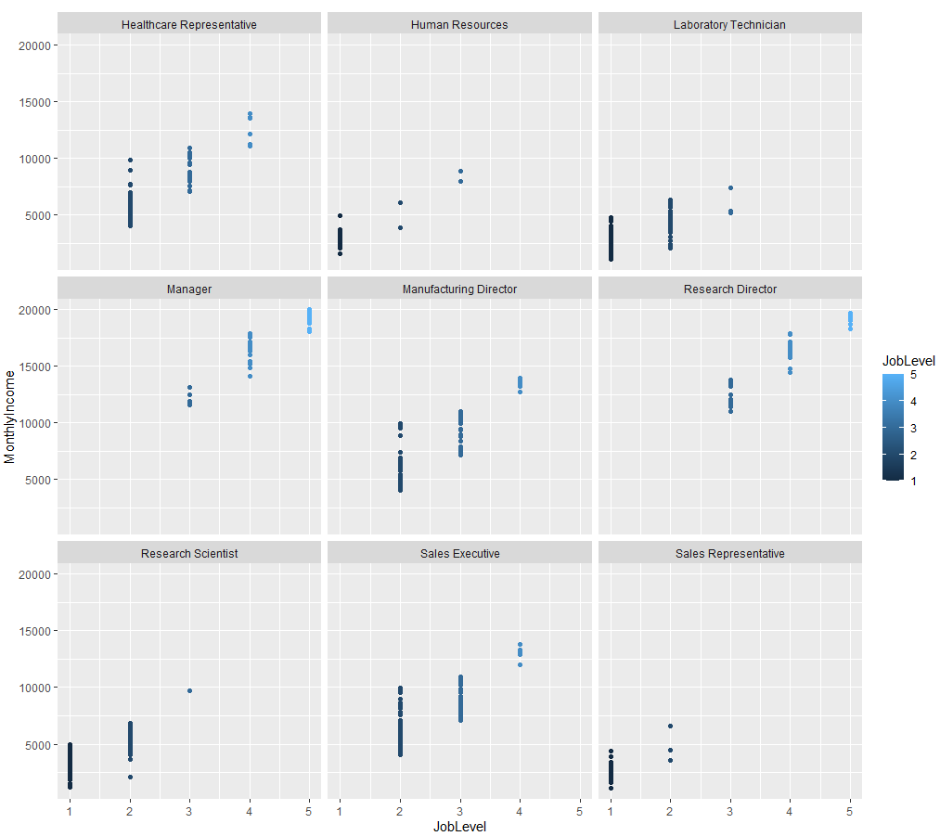
Modeling Income

Slide 14
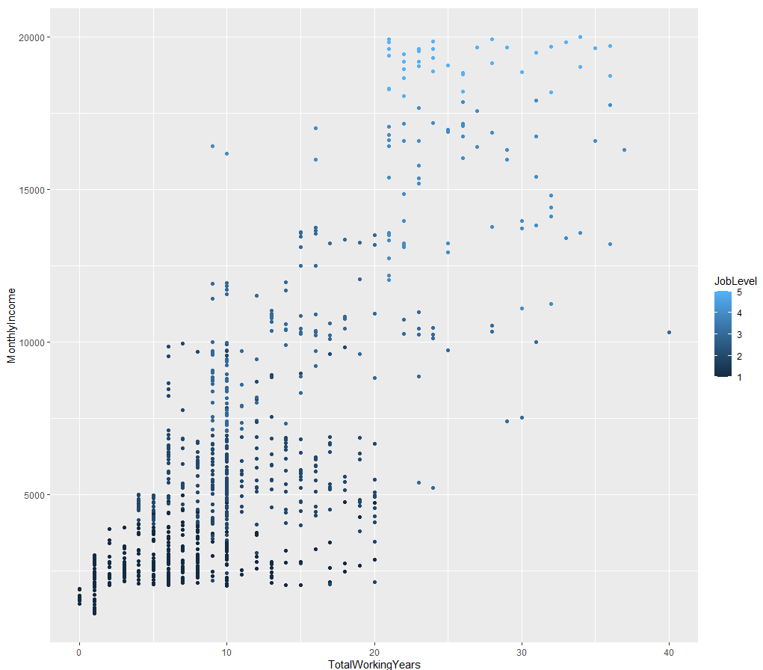
Years of Service
The best portrait that experience can lead to higher income

Slide 15
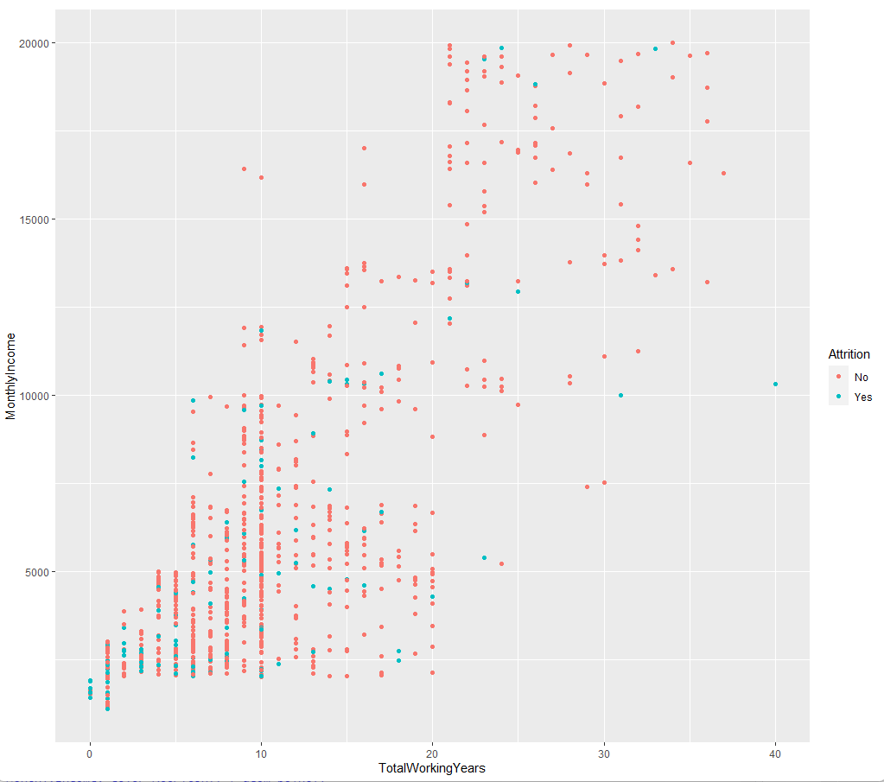
Attrition focus

Slide 16
Suggestions
These issues that are being presented with attrition often span from overwork, and the repetition of doing the same task for the same person

